Slide 1
School of AI
Trivandrum

Slide 2

Reinforcement Learning: Q-Learning

Slide 3

Plan of Attack
What is Reinforcement Learning?
The Bellman Equation
The “Plan”
Markov Decision Process(MDP)
Policy vs Plan
Adding a “Living Penalty”
Q-Learning intuition
Temporal Difference

Slide 4
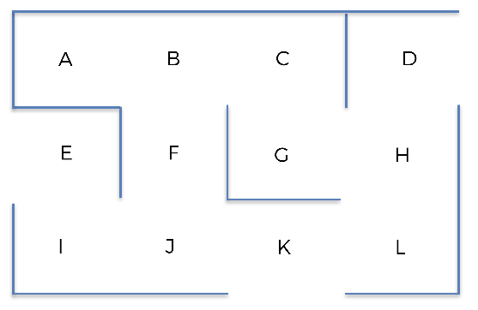
Optimize Warehouse Flows
Notes:
- keeps on doing actions
- changing the state
- while exploring it learns what actions lead to good rewards and favorable states and what actions the rewards an unfavorable state.

Slide 5
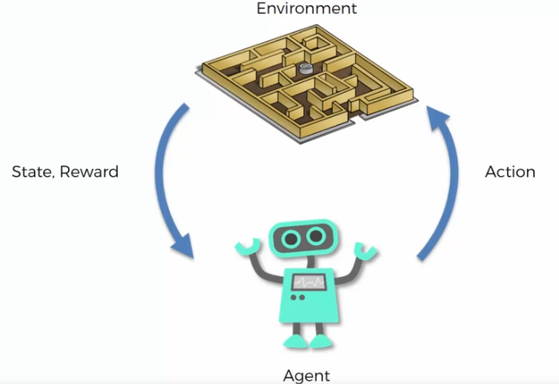
Reinforcement Learning
Notes:
- keeps on doing actions
- changing the state
- while exploring it learns what actions lead to good rewards and favorable states and what actions the rewards an unfavorable state.

Slide 6
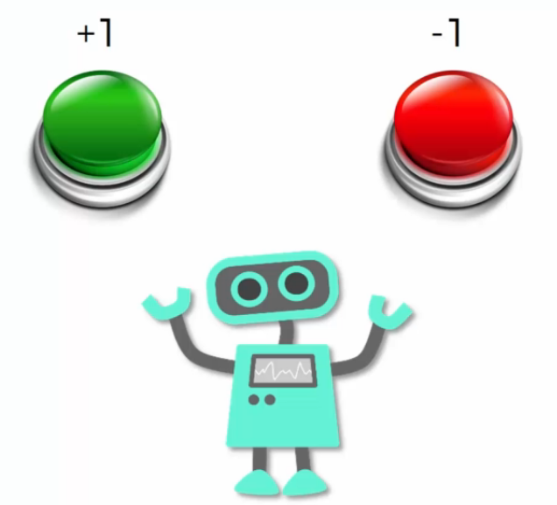
Reinforcement Learning

Slide 7
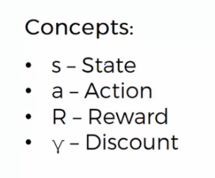
The Bellman Equation

Slide 8
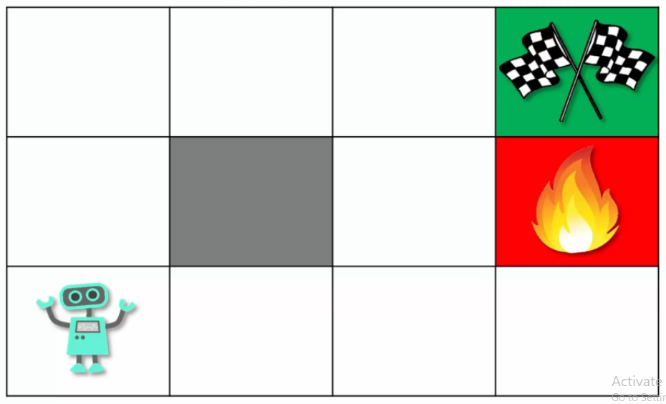
The Bellman Equation

Slide 9
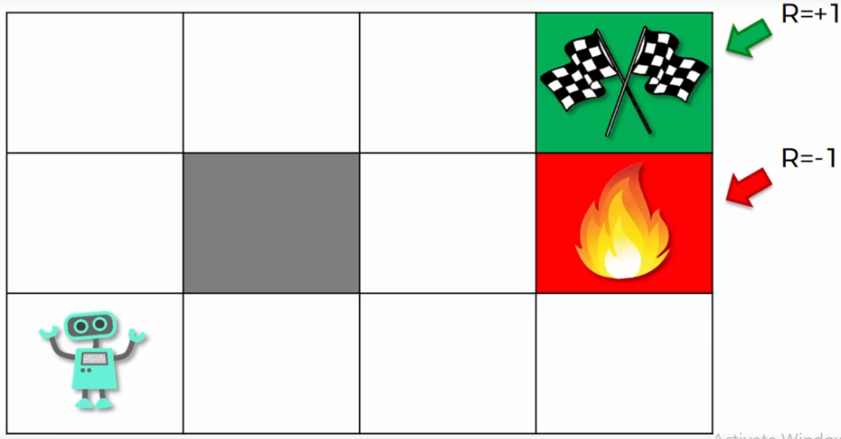
The Bellman Equation

Slide 10
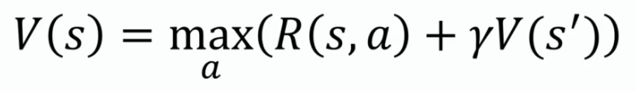
The Bellman Equation

Slide 11
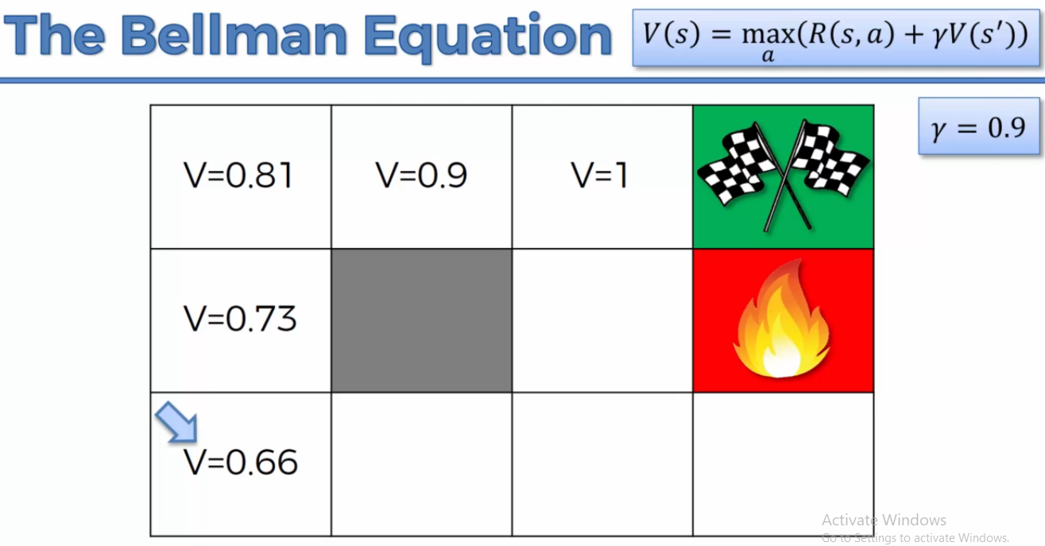
The Bellman Equation

Slide 12
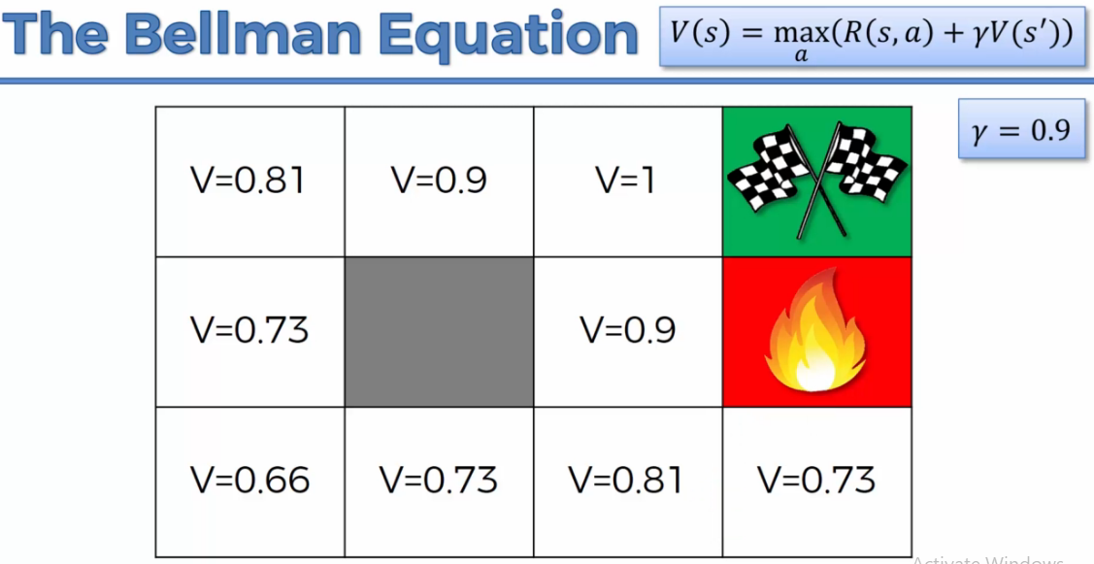
The Bellman Equation

Slide 13
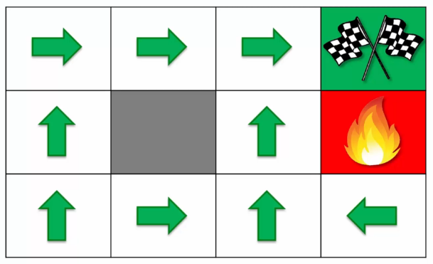
The “Plan”

Slide 14
The “Plan”

Slide 15
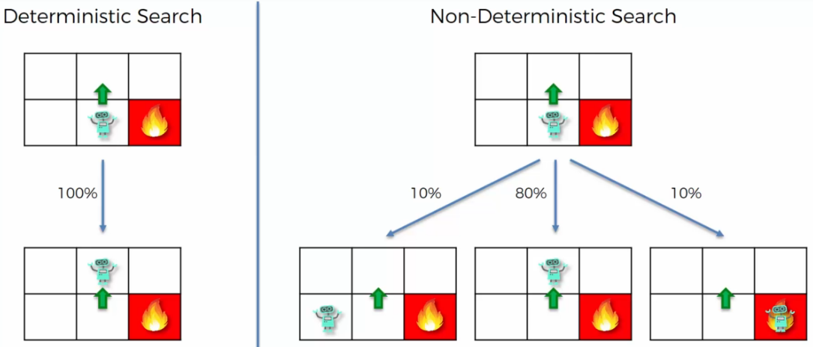
Markov Decision Process(MDP)

Slide 16
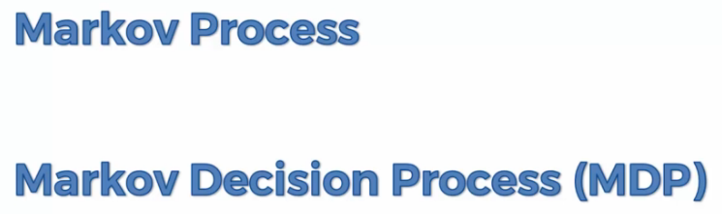
Markov Decision Process(MDP)

Slide 17
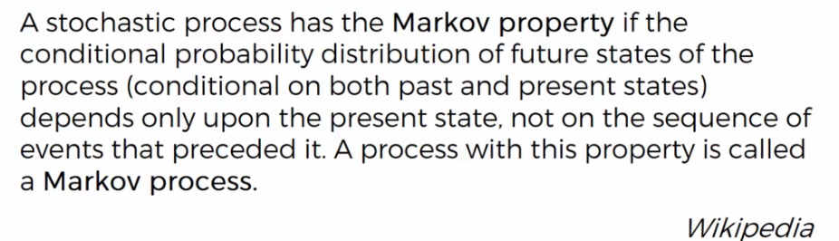
Markov Decision Process(MDP)

Slide 18
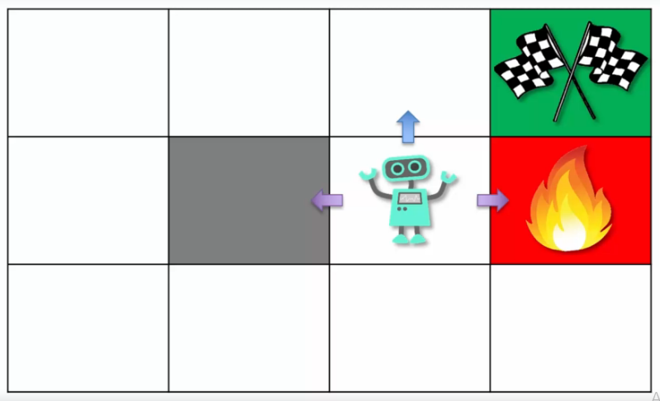
Markov Decision Process(MDP)

Slide 19
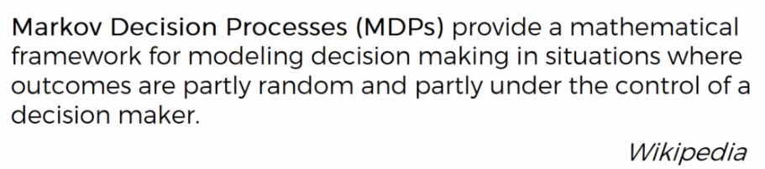
Markov Decision Process(MDP)

Slide 20
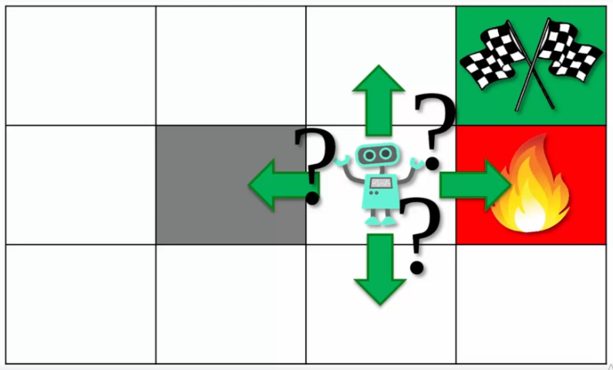
Markov Decision Process(MDP)

Slide 21
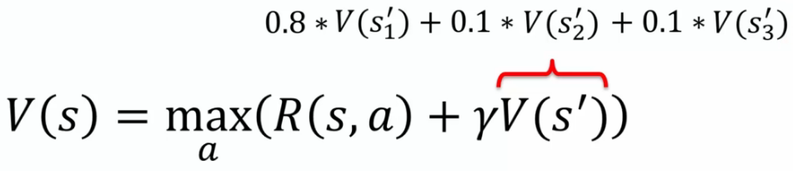
Markov Decision Process(MDP)

Slide 22
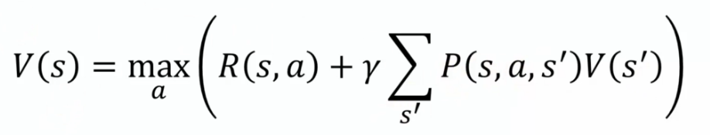
Markov Decision Process(MDP)

Slide 23
Markov Decision Process(MDP)

Slide 24
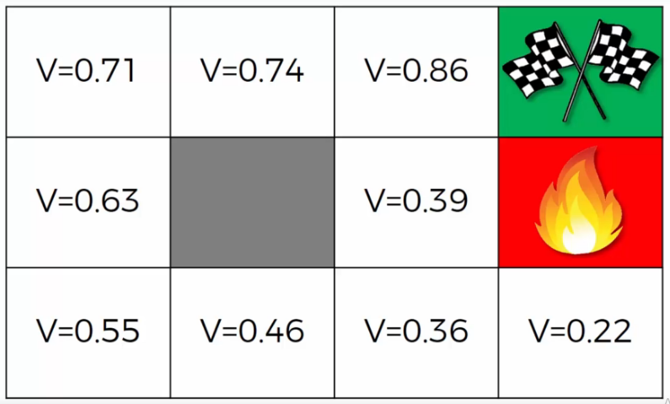
Policy vs Plan

Slide 25
Policy vs Plan

Slide 26
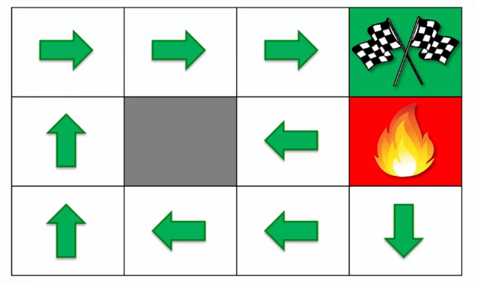
Policy vs Plan

Slide 27
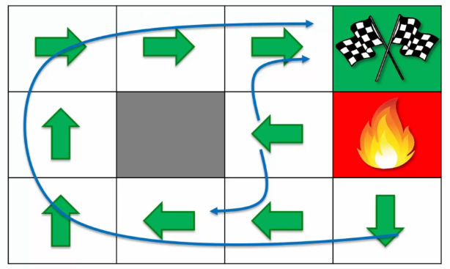
Policy vs Plan

Slide 28
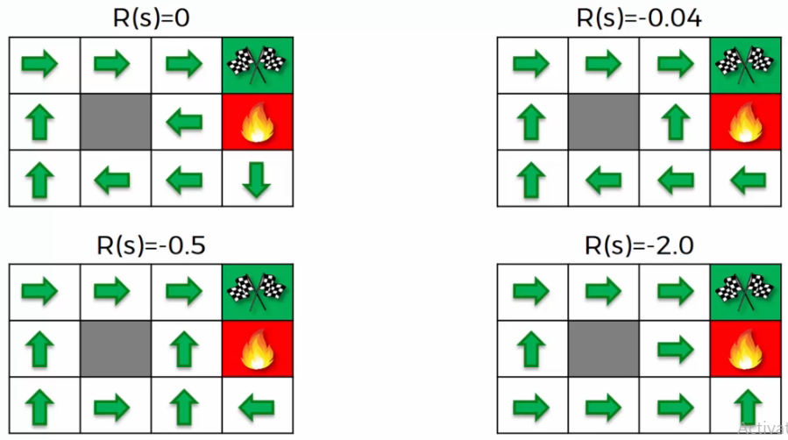
Living Penalty

Slide 29

Thank You!

